Slide 1


Architecture of Complex Systems
Week 1: Systems Thinking
Project Portfolio
Name
Tomas Mawyin

Slide 2
Instructions
Before you begin, you should save your Project Portfolio on your local drive. We recommend the following format:
Lastname_Firstname_Course1_Week1
Please note: You will not be able to re-download your file after submission; therefore, please keep this file in a central location for future reference.
While you may be working with a group, the project deliverable is an individual submission. A scoring rubric can be downloaded from the course in the Resources/Downloads tab on the top navigation.
You will be self-assessing your work. If you have any questions, feel free to start a thread in the Discussion Forum. Although work is strictly individual, sharing ideas and concepts with other students or your team is encouraged.
Note: edX has a 10MB file size limit for document submission. If you have selected large image(s), you may need to resize before submitting, OR you may simply include a web URL for the image in the image location. Be sure to submit your assignment at least one hour before the deadline to provide time for troubleshooting.
Once the deadline passes, you will not be able to upload the document and therefore will not be able to submit and complete the assignment.

Slide 3
Week 1 Project
Overview
In this first project activity, you will apply the four tasks of systems thinking to a real-life “system.” You will have the option to choose from five different system types, which are shown on the next slide.
We recommend that you do some brief research on each one before choosing; however, if one is particularly relevant to your occupation, feel free to simply select that. You will then follow the steps which appear in the text box to the right to complete this activity.
REQUIRED STEPS:
Step 1: Research and select your project “system.”
Step 2: Identify the primary ENTITIES in your system.
Step 3: Identify your system’s FORM and FUNCTION.
Step 4: Identify RELATIONSHIPS in your system.
Step 5: Predict your system’s EMERGENCE.
Step 6: Develop system DECOMPOSITION.
Step 7: Review and submit your project.

Slide 4
Step 1: SYSTEM DETAILS
The following details pertain to the systems described in the previous slide and provide general guidance. You may find a specific diagram and/or schematic of the system that has a different representation. However, you are expected to work with one of the five systems described while maintaining the same level of complexity as below. For instance, you may not choose a half bit adder instead of a full bit adder.
Balsa wood glider: A beginner-level model hand-launched glider airplane composed of the following: fuselage, rear stabilizer, fin, wings, and front counterbalance weight.
Crystal radio: Simple early form of a radio receiver circuit composed of the following: variable capacitor, aerial terminal, inductor coil, diode, resistor, earplug output, and a ground terminal.
Prime number search code: C void function that prints all the prime numbers less than or equal to the number given in variable n. The function is composed of: variable n, array of length n named “primes,” for loop that flags all items in the array as prime numbers, for loop that computes for the prime numbers in the array, for loop that prints out to the prime numbers of the array.
Simple refracting telescope: Optical telescope based on two lenses. The system is composed of a focal tube, objective lens, eyepiece, eye lens, focus knob, three tripod legs, focal tube mount, and tripod flange.
One-bit full adder: Digital circuit that adds three one-bit numbers. This system is composed of two XOR gates, two AND gates, and one OR gate.

Slide 5
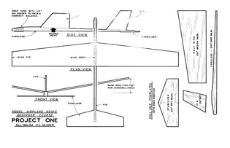
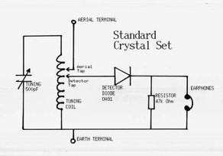
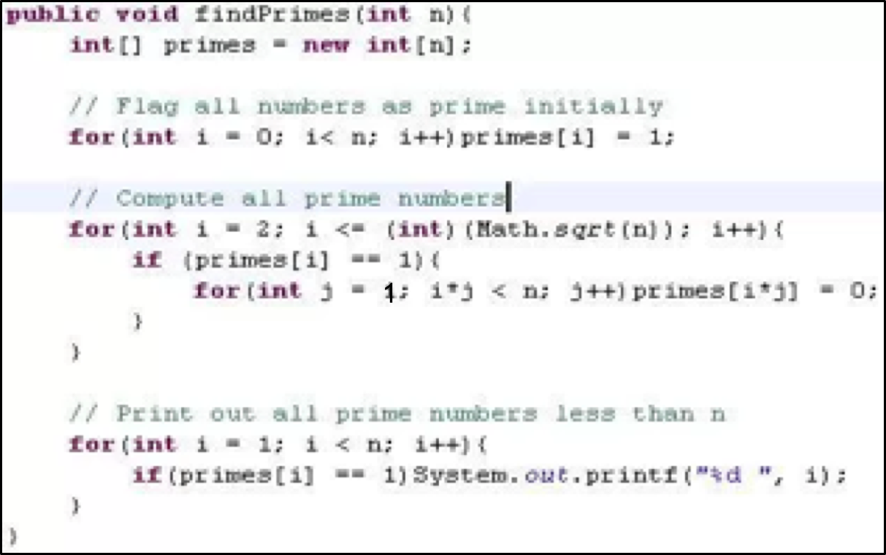
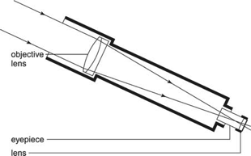
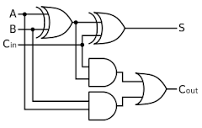
Step 1: SELECT YOUR SYSTEM
My system choice:
Balsa Wood Glider
Balsa Wood Glider
Crystal Radio
Prime Number Search Code
Simple Refracting Telescope
1-bit Adder

Slide 6

Step 2: IDENTIFY SYSTEM FORM & FUNCTION
Insert image you sourced representing your selected system in the box on the left side of the slide below. Then indicate the examples of FORM and FUNCTION that you’ve identified in the field on the right below.
Note: edX has a 10MB file size limit for document submission. If you have selected large image(s), you may need to resize before submitting, OR you may simply include a web URL for the image in the image location.
System Diagram/Schematic
Primary System FORM:
Balsa Wood Glider
Primary System FUNCTION:
Gliding
Please describe why these elements of your system represent form and function and contextual interrelationship.
Insert image here.
As form I choose Balsa Wood Glider because it represents what the system is – what gets built at the end and it’s what allows the function of gliding to exist. Gliding or flying is what the system does when hand-launched.

Slide 7
Step 3: IDENTIFY SYSTEM ENTITIES
Copy the image you inserted into Slide 6 here. Then highlight or circle the different entities in your system and indicate them along with their respective form and function in the fields at right.
Note: edX has a 10MB file size limit for document submission. If you have selected large image(s), you may need to resize before submitting, OR you may simply include a web URL for the image in the image location.
System Diagram/Schematic
System Entity 1:
Fuselage
1
Form:
Balsa Wood Stick
Function:
z
Support all components
2
System Entity 2:
Copy the image you inserted into Slide 6 here.
Wings
Form:
Balsa Wood Wing
Function:
z
Provide lift

Slide 8
Step 3: IDENTIFY SYSTEM ENTITIES
Copy the image you inserted into Slide 6 here. Then highlight or circle the different entities in your system and indicate them along with their respective form and function in the fields at right.
Note: edX has a 10MB file size limit for document submission. If you have selected large image(s), you may need to resize before submitting, OR you may simply include a web URL for the image in the image location.
System Diagram/Schematic
System Entity 3:
Rear Stabilizer
4
Form:
Balsa Wood Stabilizer
Function:
z
Provides stability and control
System Entity 4:
Copy the image you inserted into Slide 6 here.
Fin
3
Form:
Balsa Wood Fin
Function:
z
Provide stability and control

Slide 9
Step 3: IDENTIFY SYSTEM ENTITIES
Copy the image you inserted into Slide 6 here. Then highlight or circle the different entities in your system and indicate them along with their respective form and function in the fields at right.
Note: edX has a 10MB file size limit for document submission. If you have selected large image(s), you may need to resize before submitting, OR you may simply include a web URL for the image in the image location.
System Diagram/Schematic
System Entity 5:
Counterbalance weight
5
Form:
Weight
Function:
z
Provides balance
System Entity 6:
Copy the image you inserted into Slide 6 here.
N/A
Form:
N/A
Function:
z
N/A

Slide 10
Step 4: IDENTIFY SYSTEM RELATIONSHIPS
Replace the names of Entities 1 and 2 in the diagram below with the first two entities you identified on the previous step. Identify at least 4 more entities in your system. Then, use the connectors to define the relationships between your entities. You may copy the objects you use more than once and delete any you don’t use.
Functional
Control
Wings
Formal
Fin
Physical
Connection
Control
Control
Physical
Connection
Rear Stabilizer
Fuselage
Counterbalance
Physical
Connection
Coiled
Physical
Connection
Dampening
Landing Gear

Slide 11

Step 5: PREDICT SYSTEM EMERGENCE
For this step, you will predict two types of emergence in your system: intended and unintended, including emergence failures. Write a brief description of each emergent behavior of your system, and then explain how it occurred by describing it functional emergence.
You may also upload an image for each emergence type if you prefer. Please remember the file size limit and resize or paste the image URL instead, as needed.
Intended Emergence
Unintended Emergence
Flying (Gliding)
Crashing
Functional Interaction
Functional Interaction
Components are properly attached to balance the glider and provide stability when launched in the air.
Components are not attached properly which reduces balance and stability causing the glider to crash.
(optional) Image
(optional) Image
Insert image here.
Insert image here.

Slide 12
Step 6: DEVELOP SYSTEM DECOMPOSITION
For your last step, develop a Level One system decomposition. Draw a decompositional view of your system that includes Level Zero and Level One.
Glider
Fuselage
Wings
Rear Stabilizer
Fin
Counterbalance

Slide 13
STEP 7: REVIEW & SUBMIT PROJECT
Submit and self assess your completed Week 1 Project Portfolio file Note: The maximum file size that can be submitted is 10MB.
A sample project submission and scoring rubric can be downloaded from the course in the Resources/Downloads tab on the top navigation.
Please remember that there are two steps to this assignment: Submission and self assessment. Please be sure to provide enough time to complete both steps.

